Slide 1
PRDA – 1 Profit Analysis
Startup Profit Prediction Analysis Using Multiple Linear Regression
PRABU R
Datamites Internship
27-05-2026

Slide 2
Problem Statement
Startup profitability depends on multiple investment factors.
This project analyzes spending patterns and predicts profit using regression analysis.

Slide 3
Objective
Analyze startup dataset
Identify factors affecting profit
Predict future profit
Compare state-wise performance
Generate business insights

Slide 4
Dataset Understanding
Input Features
R&D Spend
Administration Spend
Marketing Spend
State
Target Variable
Profit

Slide 5
Data Preprocessing
Steps Performed
Checked missing values
Cleaned dataset
Retained State for state-wise dashboard analysis
Created Predicted Profit column
Calculated Residual Error
Added Category column

Slide 6
Regression Analysis
Model Used:
Multiple Linear Regression
Formula:
Predicted Profit = β₀ + β₁(R&D Spend) + β₂(Administration) + β₃(Marketing Spend)
Purpose:
To predict startup profit based on investment factors.

Slide 7
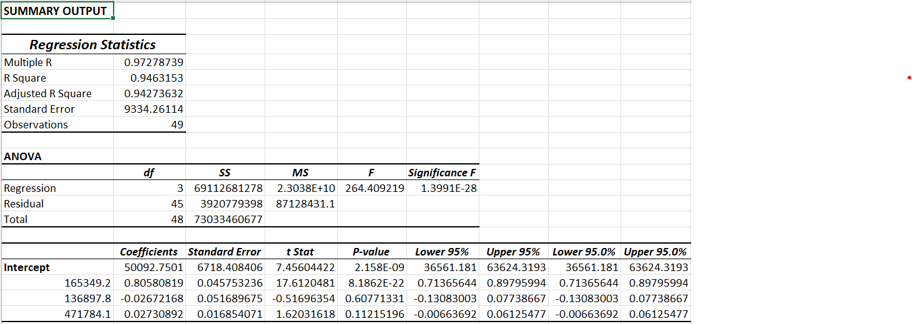
Excel Regression Output
Regression Statistics
Coefficients
R-square value

Slide 8
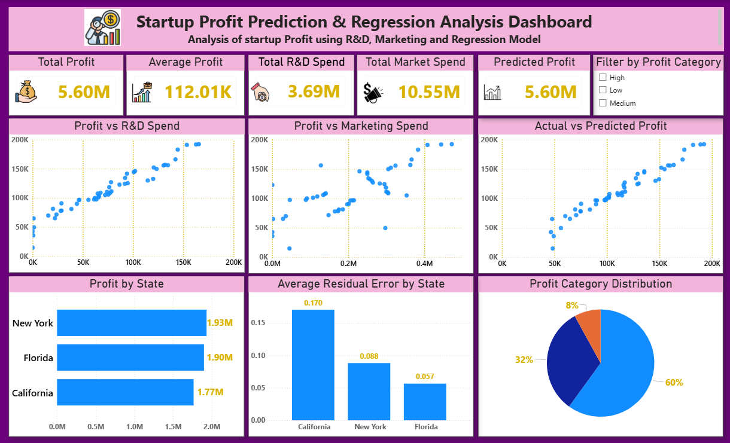
Power BI Dashboard

Slide 9
Key Insights
Business Insights
Higher R&D spend increases profit
Marketing spend positively impacts profitability
Profit varies across states
Predicted profit closely matches actual profit
Residual error indicates prediction accuracy

Slide 10
Business Recommendations
Recommendations
Increase R&D investment
Optimize marketing budget
Focus on profitable states
Monitor prediction deviations regularly

Slide 11
Conclusion
Multiple Linear Regression successfully predicted startup profit.
Power BI dashboard provides actionable insights for decision-making

Slide 12
Thank You

